Slide 1
Supply Chain Management
M S Geethanjali

Slide 2
Business Problem Understanding
Objective -An FMCG company entered into the instant noodles business two years back. Their higher management has noticed that there is a miss match in the demand and supply. Where the demand is high, supply is pretty low and where the demand is low, supply is pretty high. In both ways, it is an inventory cost loss to the company; hence, the higher management wants to optimize the supply quantity in every warehouse in the entire country.
Scope – To build a model, using historical data that will determine the optimum weight of the product to be shipped each time to the warehouse
Significance of the project – Demand forecasting also becomes very key as this is the driving force behind the entire process. The aims to create a value chain between the demand and supply, with optimum utilization of all resources.

Slide 3
Agenda
Data Overview
Data Preprocessing
Exploratory Data Analysis
Modelling Approaches
Model Evaluation
Results
Conclusion

Slide 4
Data Overview
No of Columns– 24
No of Rows– 25000 Nos
Column Names:
Ware_house_ID, WH_Manager_ID, Location_type, WH_capacity_size, zone,
WH_regional_zone,num_refill_req_l3m,transport_issue_l1y,Competitor_in_mkt,
retail_shop_num, wh_owner_type,distributor_num,flood_impacted,flood_proof,
electric_supply,dist_from_hub,workers_num,wh_est_year,storage_issue_reported_l3m,
temp_reg_mach,approved_wh_govt_certificate,wh_breakdown_l3m, govt_check_l3m,product_wg_ton

Slide 5
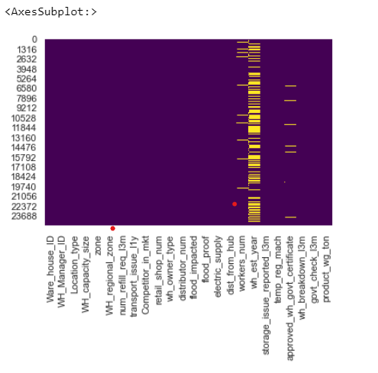
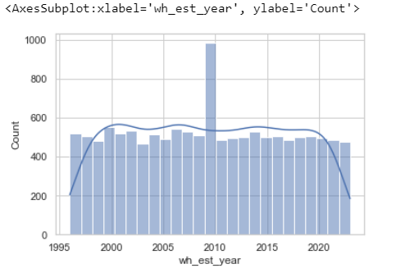
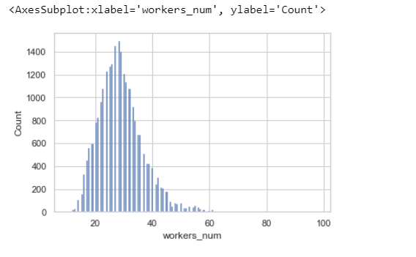
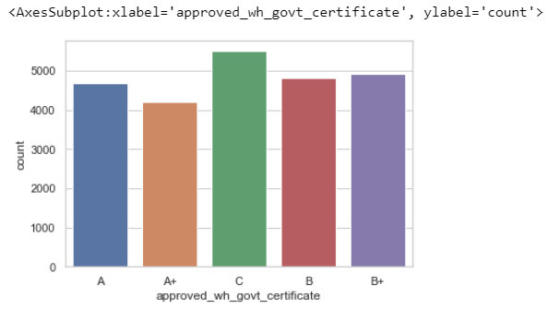
Data Preprocessing
Missing values are present in three columns workers_num, wh_est_year,approved_wh_govt_certificate
Missing values are filled with median in workers_num, wh_est_year and with ffill in approved_wh_govt_certificate

Slide 6
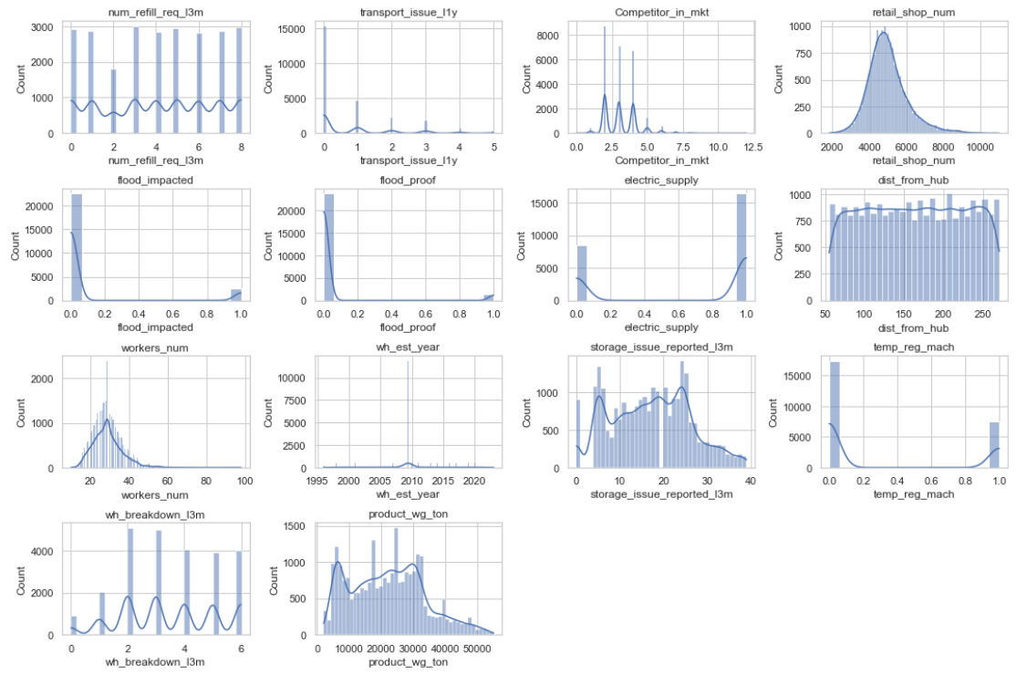
Exploratory Data Analysis
* num_refill_req_l3m:slightllyeft-skewed distribution . Most warehouses have a moderate level of refill requests, but a few experience significantly higher numbers.
* transport_issue_l1y: Right-skewed distribution. Most warehouses have a low number of transport issues, but a few have a higher frequency.
* Competitor_in_mkt:Majority of warehouses face competition from 2 to 3 competitors. Fewer warehouses experience higher levels of competition.
* Retail_shop_num:Somewhat right-skewed distribution. Most warehouses have a moderate number of retail shops, but some have a higher count.
* dist_from_hub:Distribution of distances from the warehouse to the production hub is spread out.
* workers_num: Moderately right skewed with Peak around 28 workers, suggesting many warehouses have a similar number of workers.
* product_wg_ton: Slightly right skewed distribution. Warehouses produce noodles with a variety of product weights.

Slide 7
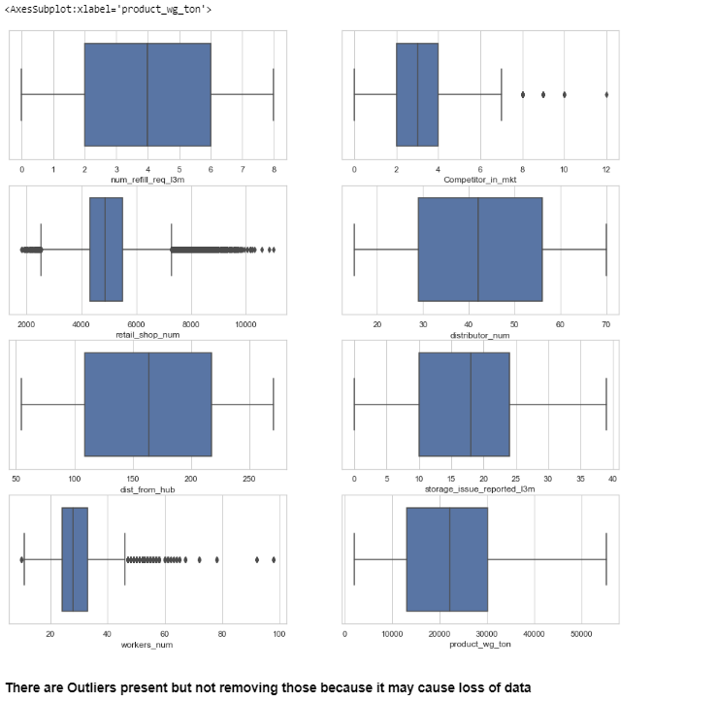
Exploratory Data Analysis

Slide 8
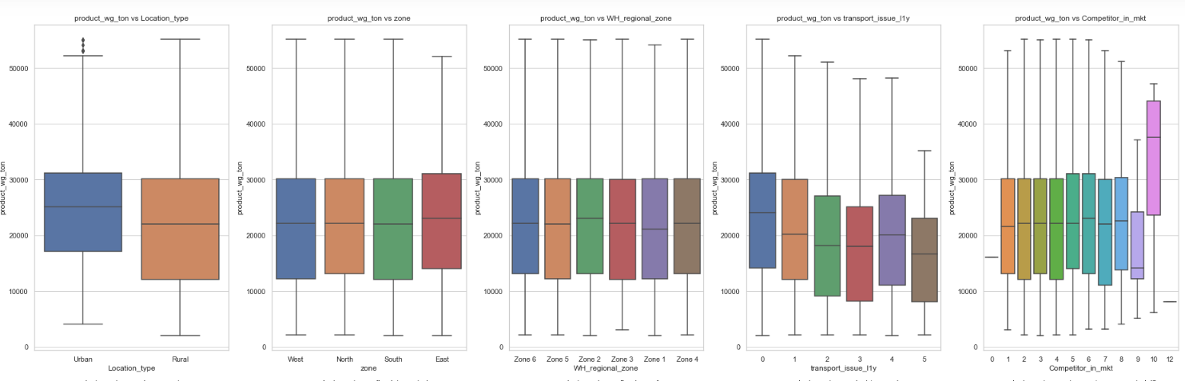
Bivariate Analysis of categorical variables with product weight in tons
Rural Influence on Product Weight:
* The data suggests that product weight tends to be higher in rural areas.
Zone-wise Disparities:
* Analysis by zone indicates a predominant contribution from the west and south zones in terms of product weight. Interestingly, zones 6, 5,2 and 4 exhibit substantial contributions as well.
Competitor Dynamics:
* There is a positive correlation between higher product_wg_ton and an increased presence of competitors in the market.

Slide 9
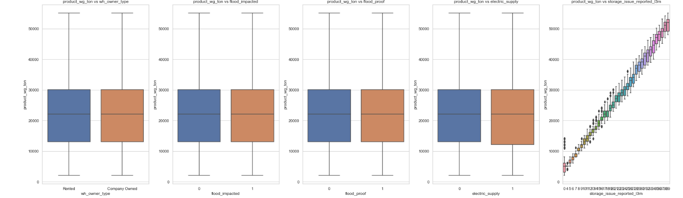
Warehouse Ownership Impact:
* Warehouses owned by the company or rented appear to be similar in terms of product weight.
Flood Resilience:
* Factors such as flood-proof infrastructure and flood impact exhibit relatively lower significance concerning product_wg_ton.
Storage Challenges:
* A notable finding is that as product_wg_ton increases storage issues also increases

Slide 10
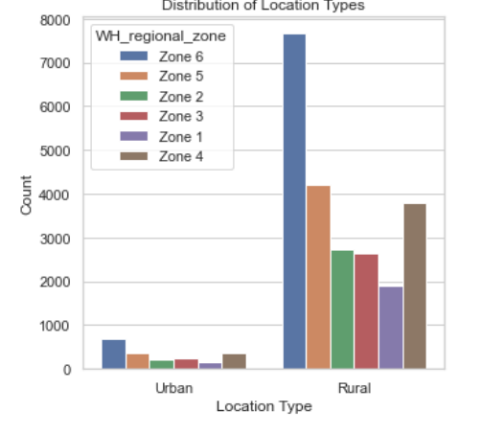
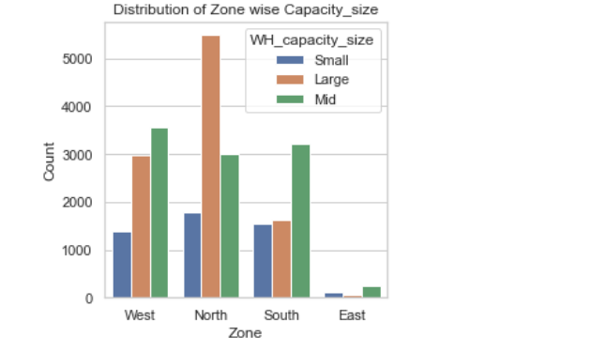
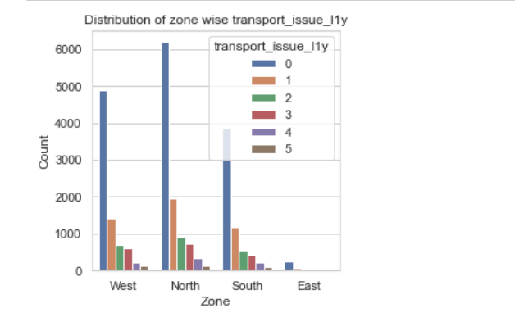
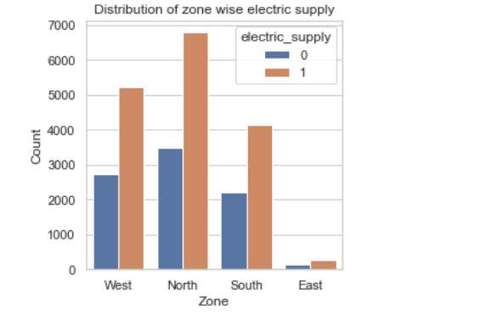
Bivariate Analysis
More no of zones are present in rural areas
Large capacity warehouses are present in north followed by the West and South.
Transport issues are peak in North zones
Electric supply problems are most prevalent in the North, underscoring a critical infrastructure concern

Slide 11
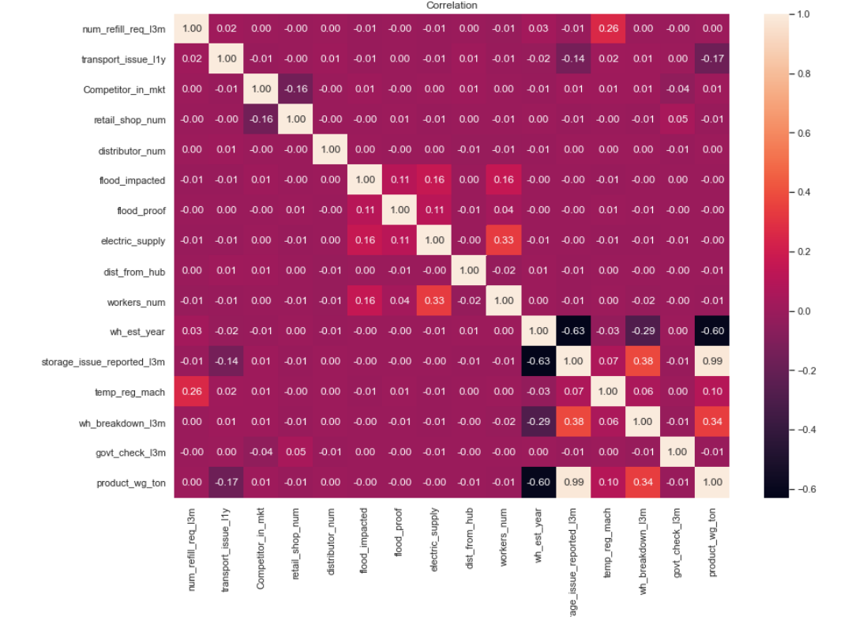
Correlation Matrix
* There is a robust positive correlation (coefficient = 0.99) between the number of storage issues reported in the last 3 months and the weight of products shipped. This suggests a significant relationship, implying that as the instances of storage issues increase, the weight of products shipped from the warehouse tends to rise correspondingly.
* The positive correlation coefficient of 0.34 between warehouse breakdowns and product weight, while moderate, can still be considered useful in model development. It suggests that there is a noticeable relationship not as strong as the storage issues, between warehouse breakdowns and the weight of shipped products.
* A noteworthy negative correlation (coefficient = -0.61) exists between the establishment year of the warehouse and product weight. This implies that newer warehouses tend to exhibit a higher volume of product shipments compared to older ones. The negative correlation suggests that as the establishment year of the warehouse decreases (indicating a more recently established warehouse), the weight of products shipped tends to increase.
* Another positive correlation observed is that between number of workers VS electric supply and storage issues reported vs ware house break down.
* However another interesting point is that the manpower (workers_num) does not hold any positive correlation between any of the numerical variables.

Slide 12
Modelling Approaches Used :
Linear Regression -Linear regression is a simple and interpretable model that assumes a linear relationship between the independent variables and the target variable.
Decision tree regression - Decision trees recursively split the data based on features to make predictions. Each leaf node represents a prediction.
Random Forest Regression -Random Forest is an ensemble of decision trees where predictions are averaged or voted upon. It addresses the overfitting issue of individual trees.
Gradient Boosting Regression-Gradient Boosting builds trees sequentially, each correcting the errors of the previous one. It combines weak learners to form a strong learner.
XGBoost Regression-XGBoost is an optimized implementation of gradient boosting that often outperforms other algorithms. It uses regularization to control overfitting.

Slide 13
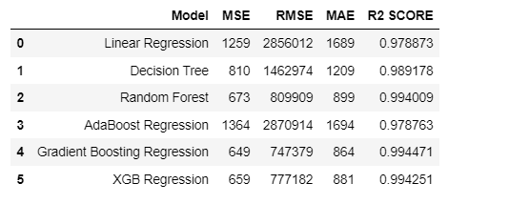
Model Evaluation

Slide 14
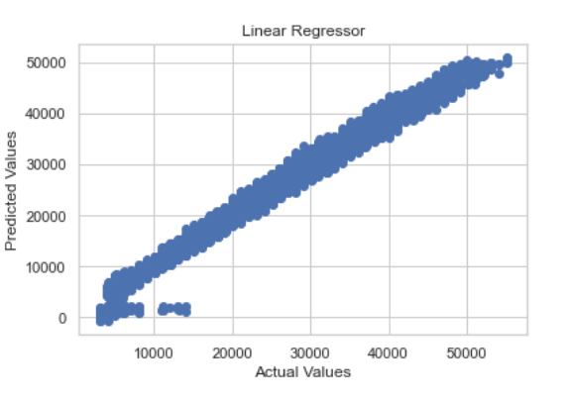
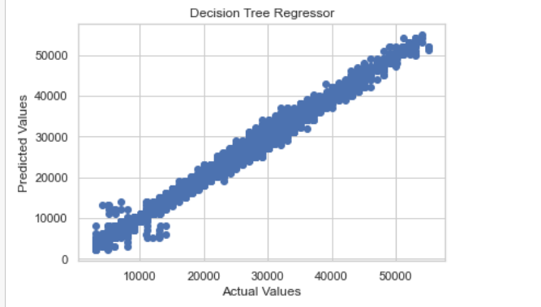
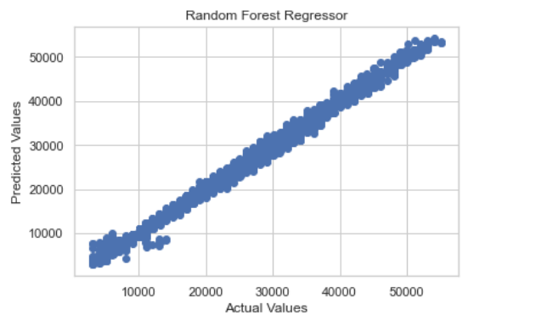
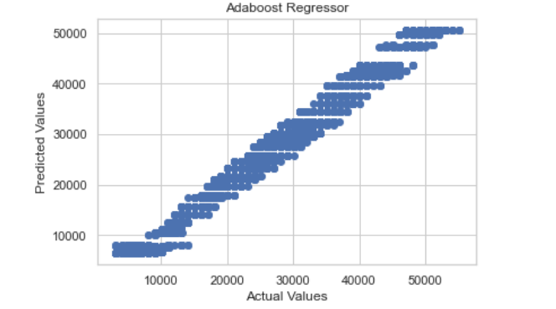
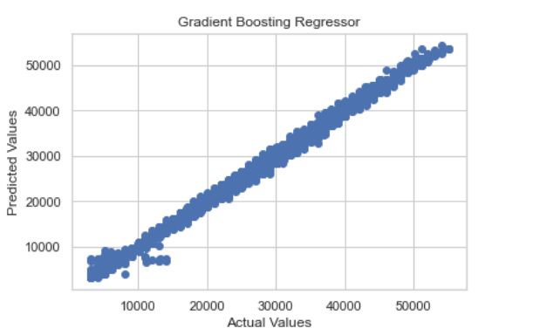
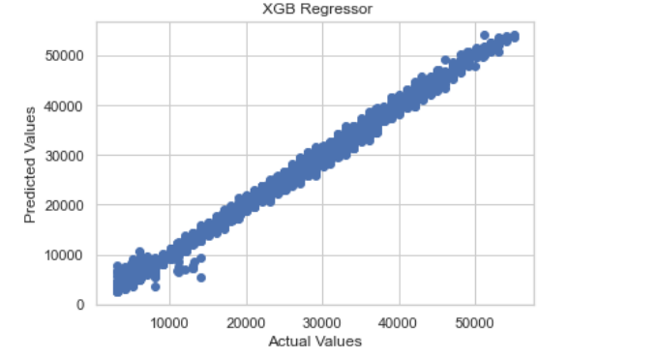
Results

Slide 15
Conclusion
Model Performance Evaluation:
The Gradient Boosting Regressor outperformed other models, achieving the lowest Root Mean Square Error (RMSE) and the highest R-squared (R2) score on the test dataset.
Variation in Demand and Supply:
Analysis of the data revealed significant variations in both demand and supply across different regions and warehouses.
Demand Forecasting: Encourages improving demand forecasting capabilities to align supply more effectively with market demand, thereby reducing the risk of overstock or understock situations.
Competitive Analysis: Advises continuous monitoring and analysis of the competitive landscape to adapt supply chain strategies accordingly.
Business Benefits:
Implementing data-driven solutions and leveraging historical data can significantly improve supply chain efficiency, reduce costs, and enhance competitiveness in the instant noodles market.
By addressing these points, the conclusion provides a comprehensive overview of the project's findings, highlights the strengths and weaknesses of various models, and offers practical recommendations for improving supply chain management in the context of the FMCG company.

Slide 16
THANK YOU

